Slide 1

CS 180 Introduction to Data Science
Introduction, Course Overview, Objectives, How to Succeed
Created by DALL-E Prompt: “Artificial Intelligence Classroom”
Notes:
<Notes>

Slide 2
Some announcements

Slide 3
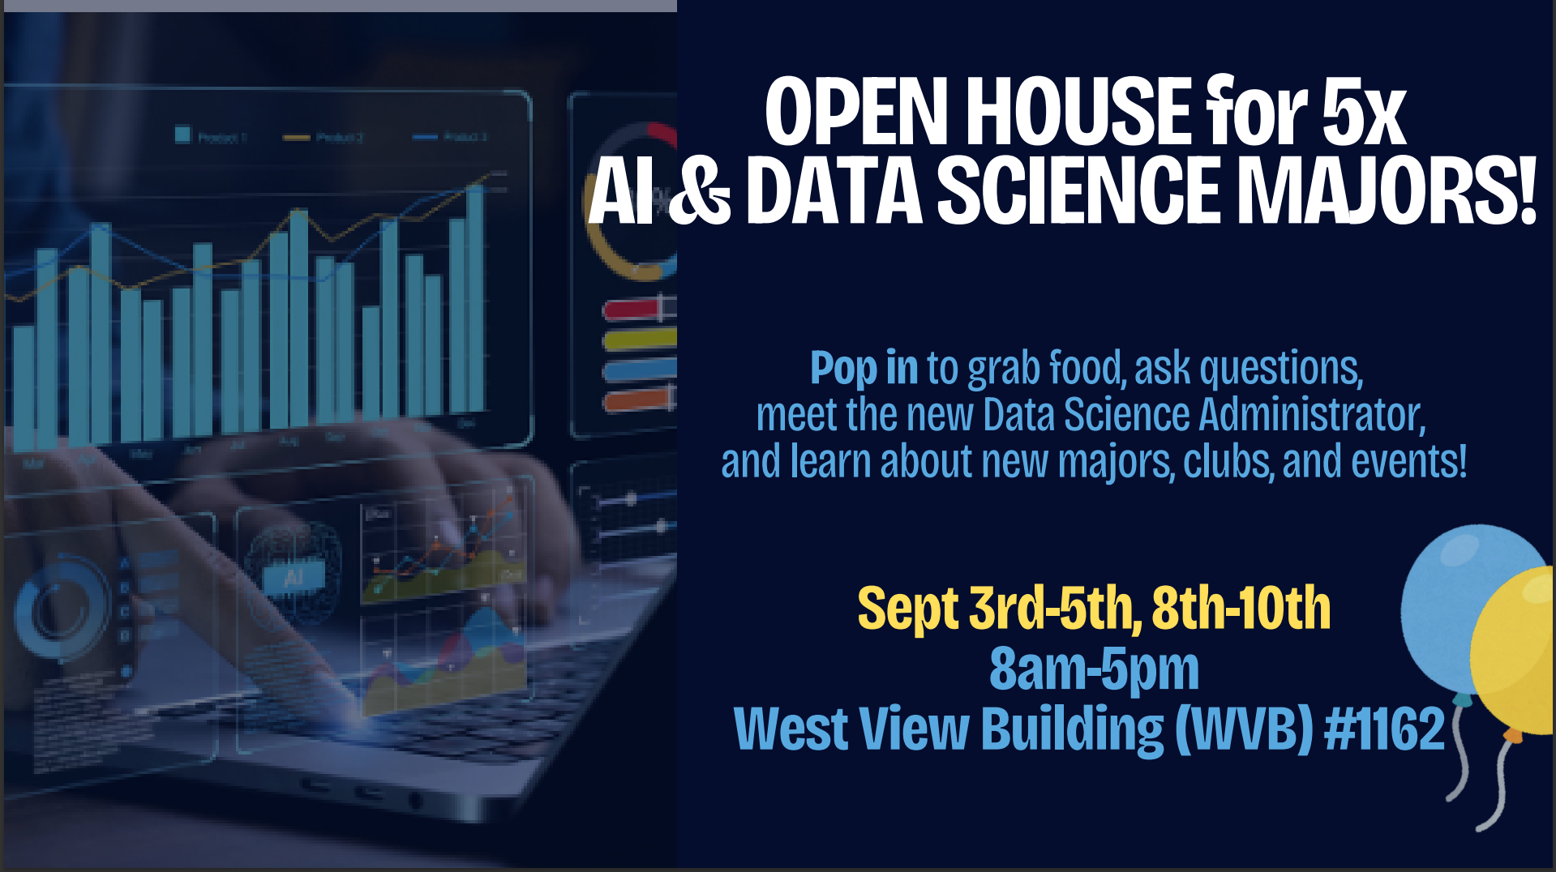

Slide 4


Slide 5


Slide 6
Announcements
Teaching Assistants (WVB 1151):
Toby Allen
Corbin Christiansen
Michael Jensen
Spencer Marshall
Ian Villanueva
Office Hours: Posted on Syllabus
Dr. Jake Rhodes
rhodes@stat.byu.edu
WVB 2177
Office Hours: TBD

Slide 7
What is Data Science?
Data Science:
Scope: focuses on data as a whole, including data collection, processing, analysis, storage, and management.
End Goals: Primarily concerned with extracting knowledge and actionable insights from data.
Techniques: Uses data collection, data cleaning, data transformation, statistical analysis, data visualization, data management and data engineering tools.
Artificial Intelligence
Data Science
Visualization
Data Analysis
Machine Learning
Streaming
Data
Statistics
Deep Learning
Large-Scale
Data Collection
Generative AI
DBMS
Data Engineering

Slide 8
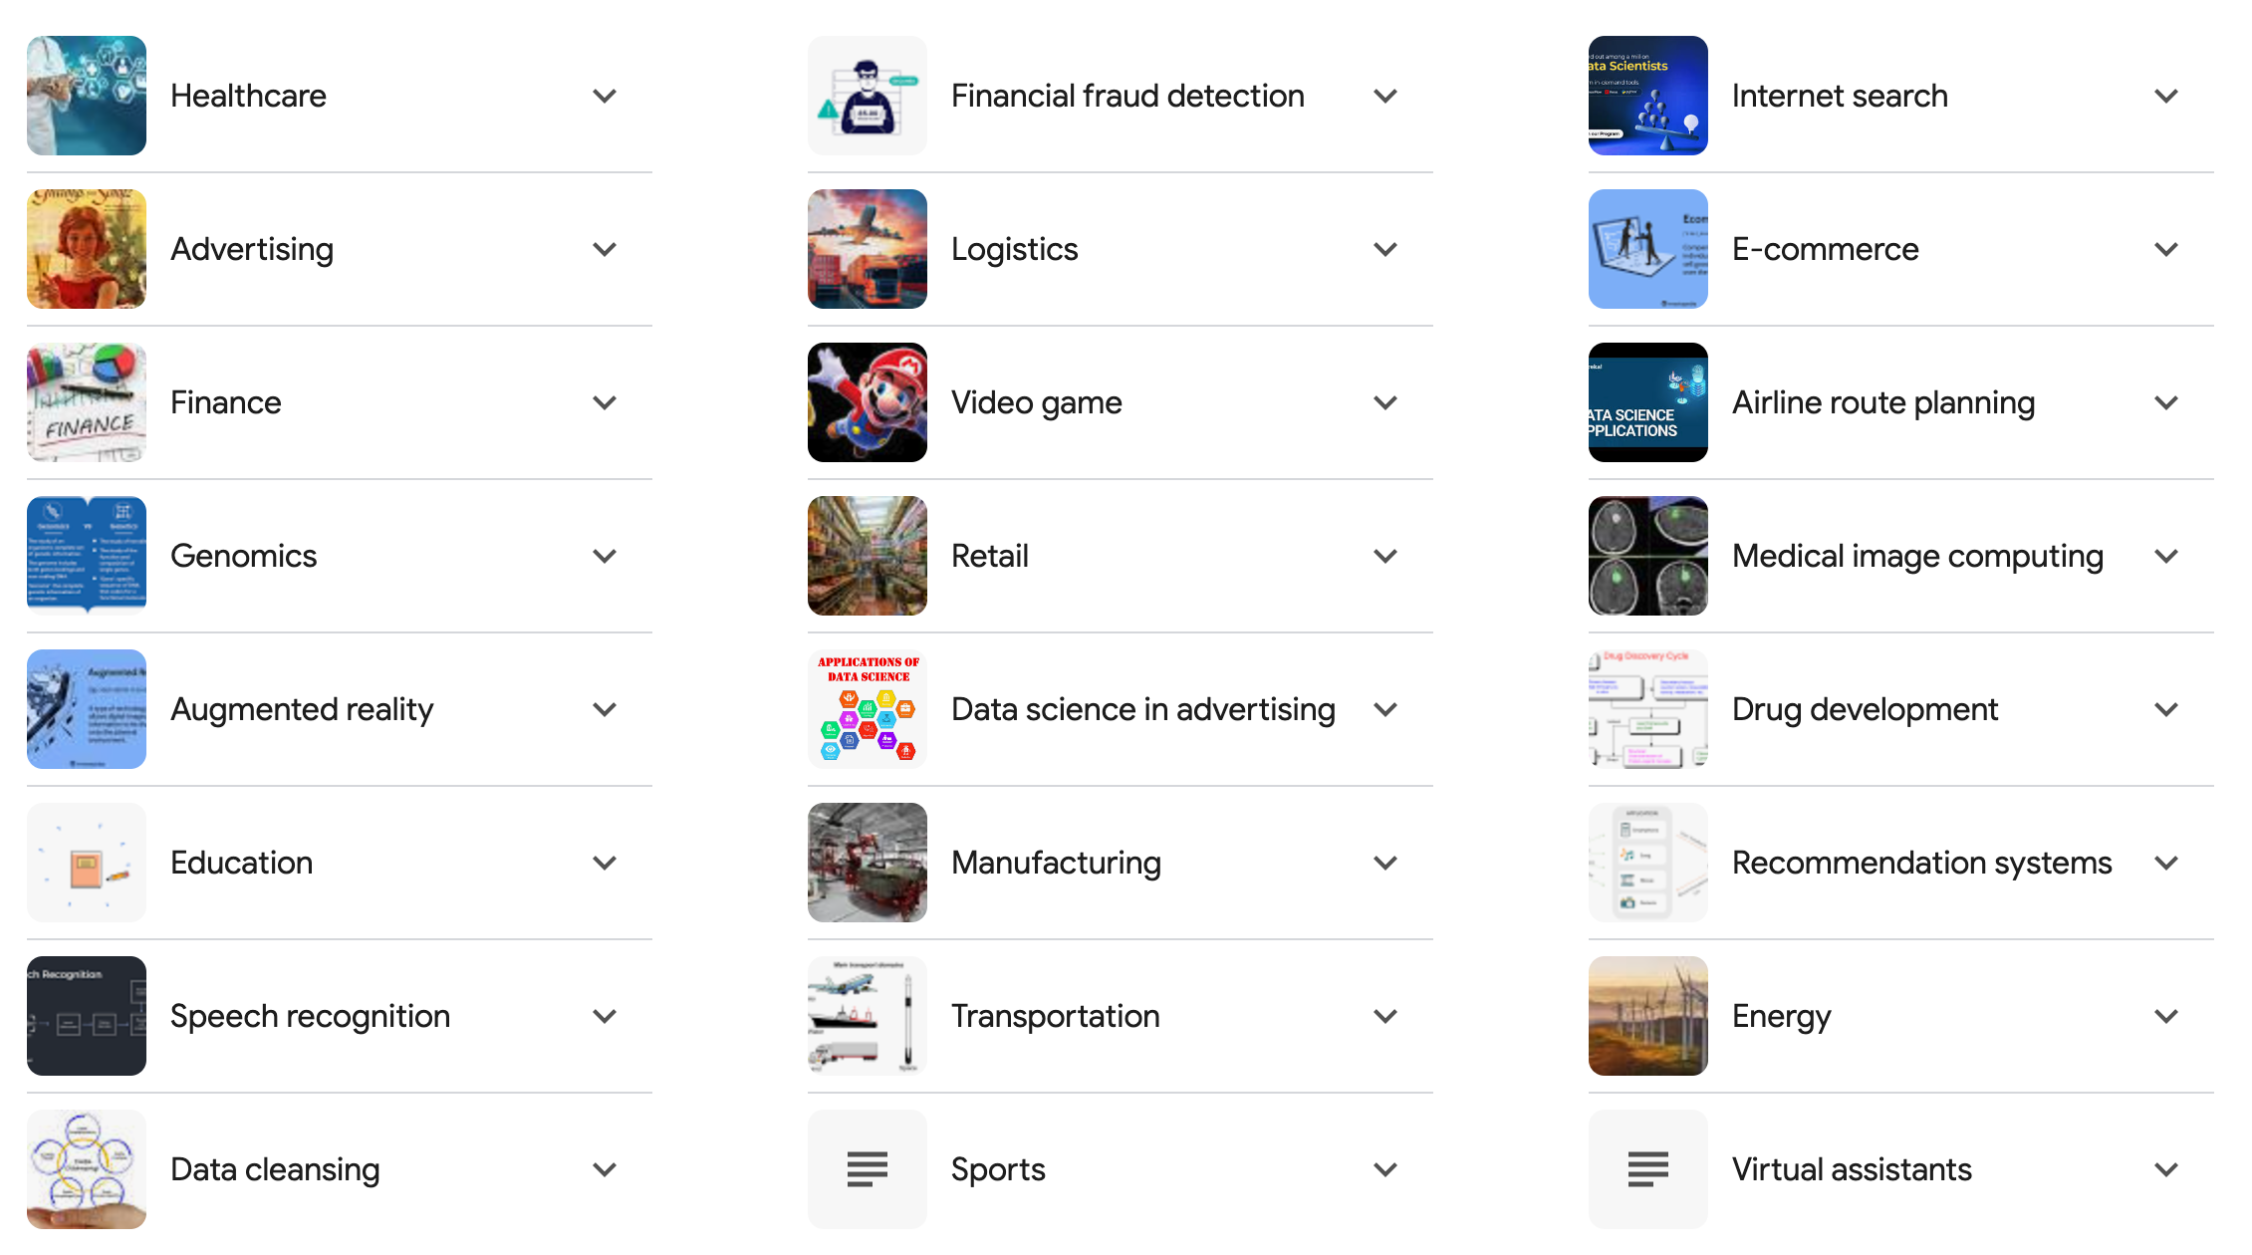
Why Data Science?
Notes:
Today, Data Science impacts almost every aspect of our lives. Applications have made breakthrough in many areas from Healthcare to Speech Recognition, Internet Search, Genomics, and everywhere in between. What DS applications are you currently using every day?

Slide 9

Tech stuff we’ll learn
Define Problem
The Data Science Lifecycle process
Using Python for data science (Numpy, Pandas, Matplotlib, Scikit-Learn, and more)
How to prepare data for analysis
How to explore data for insights
Data Visualization (Python and Tableau)
Data Management (SQL)
Machine Learning basic algorithms
Use of GenAI tools for language-based problems
Manage-Measure
Acquire Data
Data Platform
Deploy Model
Prepare Data
Build Model

Slide 10


Gen AI Applications
Code
Video
Text
suno.com
Image
Audio/Music

Slide 11
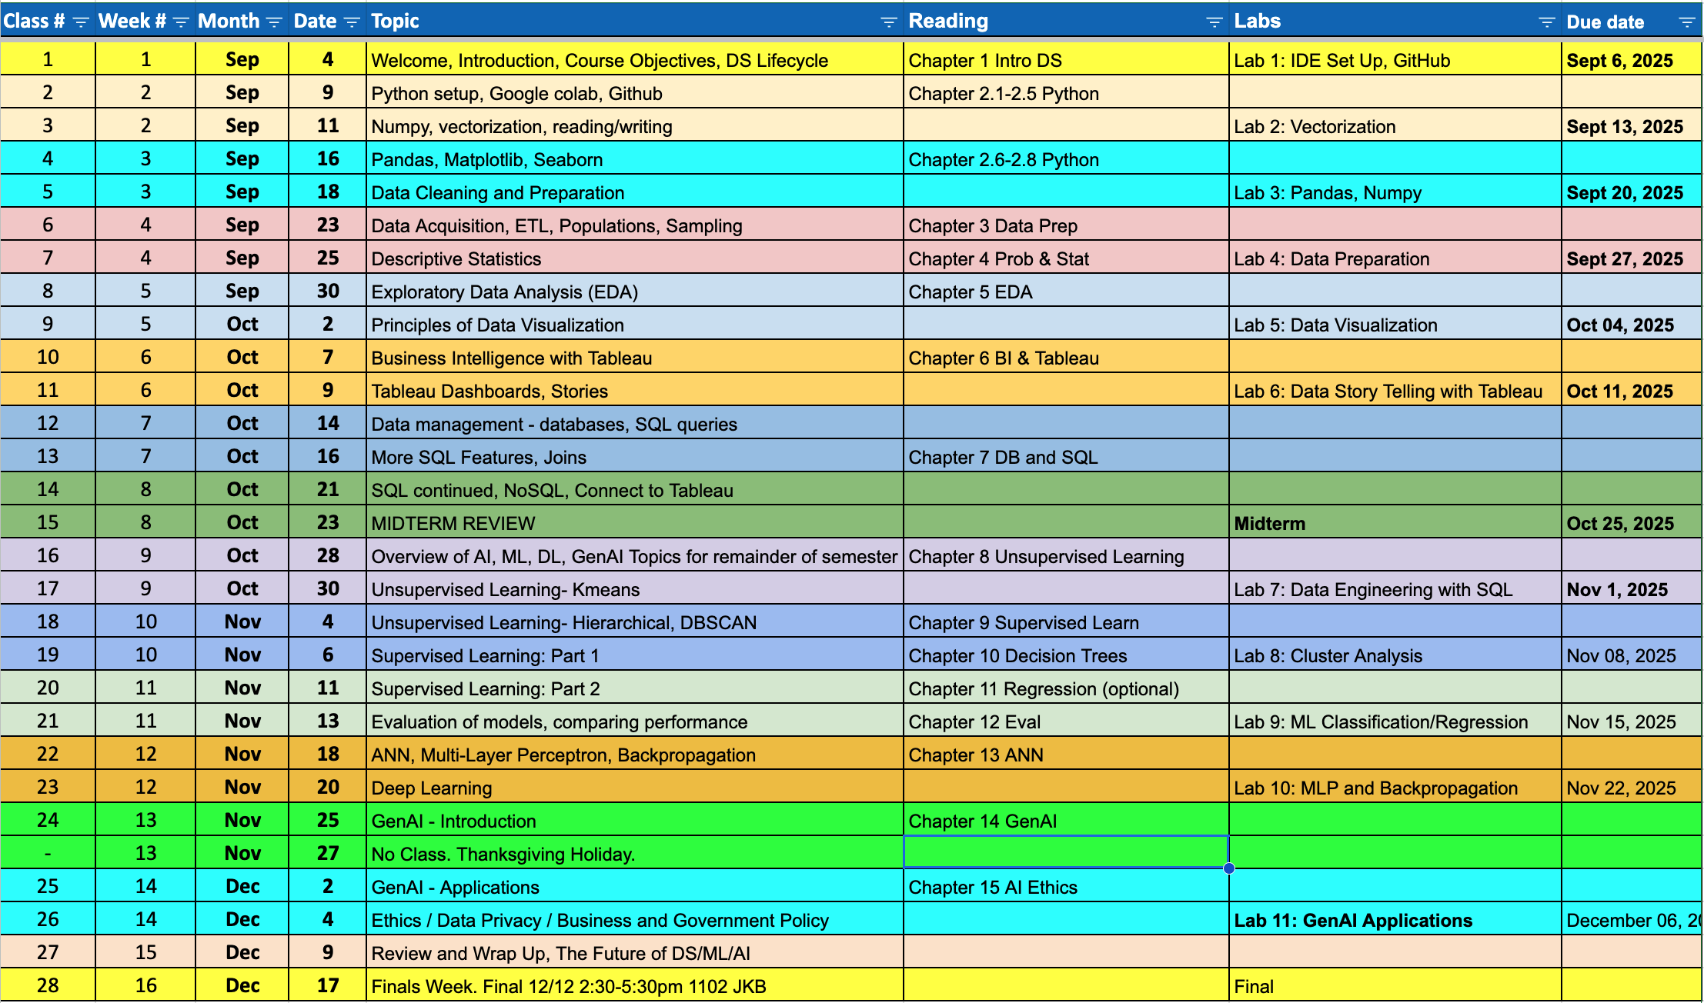
We will cover a Lot this Semester!

Slide 12
Course Goals
Enhance your ability to quickly learn and master new concepts
Utilize cutting-edge data science languages and tools to extract insights from data
Effectively communicate insights through data visualization, dashboards, data storytelling
Think critically about conclusions drawn from data analysis
Recognize the potential to do good by applying Data Science to address critical global problems

Slide 13
We are a Learning Community
Definition: A group of people who come together with the shared goal of learning, growing, and improving—often through collaboration, discussion, and mutual support. [ChatGPT]
Get to know each other. How?
At the beginning of every class, introduce yourself to those around you.
Benefits: More effective learning, better performance, build a social network, better sense of belonging, and it’s more fun!

Slide 14
AI “Policy”
Generative AI tools like ChatGPT, Gemini, Claude, Grok, etc., can be helpful to assistants in the learning process.
If misused, GenAI can become a crutch, lead to sloppy thinking, and even a substitute for engagement with real people.
We want you to have the best learning experience, resulting in foundational understanding and deep skill development.
We recommend limiting GenAI use to answering questions about topics, looking up syntax for code, and understanding code examples, but not using GenAI to answer coding questions end-to-end.
We trust you will follow this recommendation (aka policy). We will not police you, but if it is obvious, we will bring this to your attention.
To help you better learn, we will have portions of the mid-term and final that you can’t do with AI. As a result, it will benefit you to know the concepts to the point where you do not need AI.

Slide 15
Upcoming Assignments
Sign up for zyBook. How? Go to the first reading assignment in Canvas and click “Load Chapter 1 Reading…” This will initiate the process of buying the zyBook. You should not have to do this again.
Reading Assignment: Chapter 1. Points automatically accrue as you do the activities in the book.
Data Science Lab 1: Intro to Colab. Set up a Python Development Environment. Programming assignments will be turned in via Google Colab notebooks. However, if you are planning a career requiring programming, I recommend using a professional IDE, such as VS Code. If needed, we’ll go through the setup quickly next week.
Getting Set Up “Assignment”: This will help you (and me) hit the ground running!

Slide 16
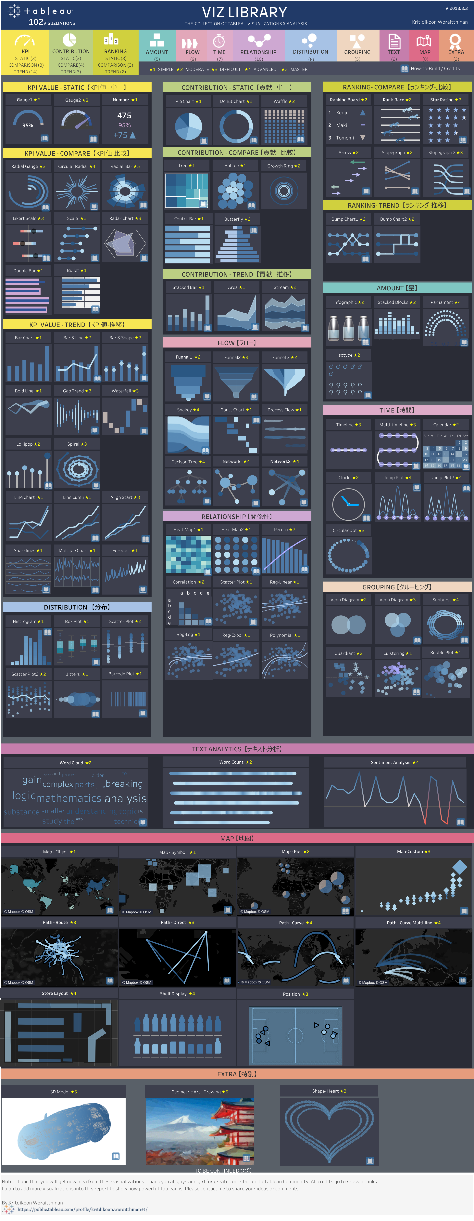
Let’s Dive In!

Slide 17

What do you see?
What should you do?
Analyze or act?

Slide 18
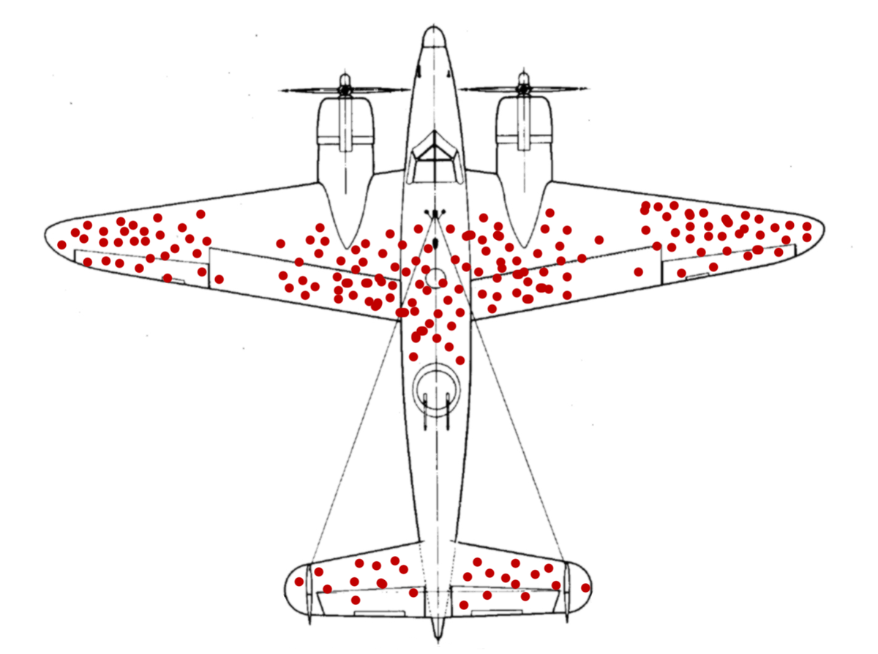
Notes:
Back during World War II, the RAF lost a lot of planes to German anti-aircraft fire. So they decided to armor them up. But where to put the armor? The obvious answer was to look at planes that returned from missions, count up all the bullet holes in various places, and then put extra armor in the areas that attracted the most fire.
Obvious but wrong. As Hungarian-born mathematician Abraham Wald explained at the time, if a plane makes it back safely even though it has, say, a bunch of bullet holes in its wings, it means that bullet holes in the wings aren’t very dangerous. What you really want to do is armor up the areas that, on average, don’t have any bullet holes. Why? Because planes with bullet holes in those places never made it back. That’s why you don’t see any bullet holes there on the ones that do return. Clever!

Slide 19
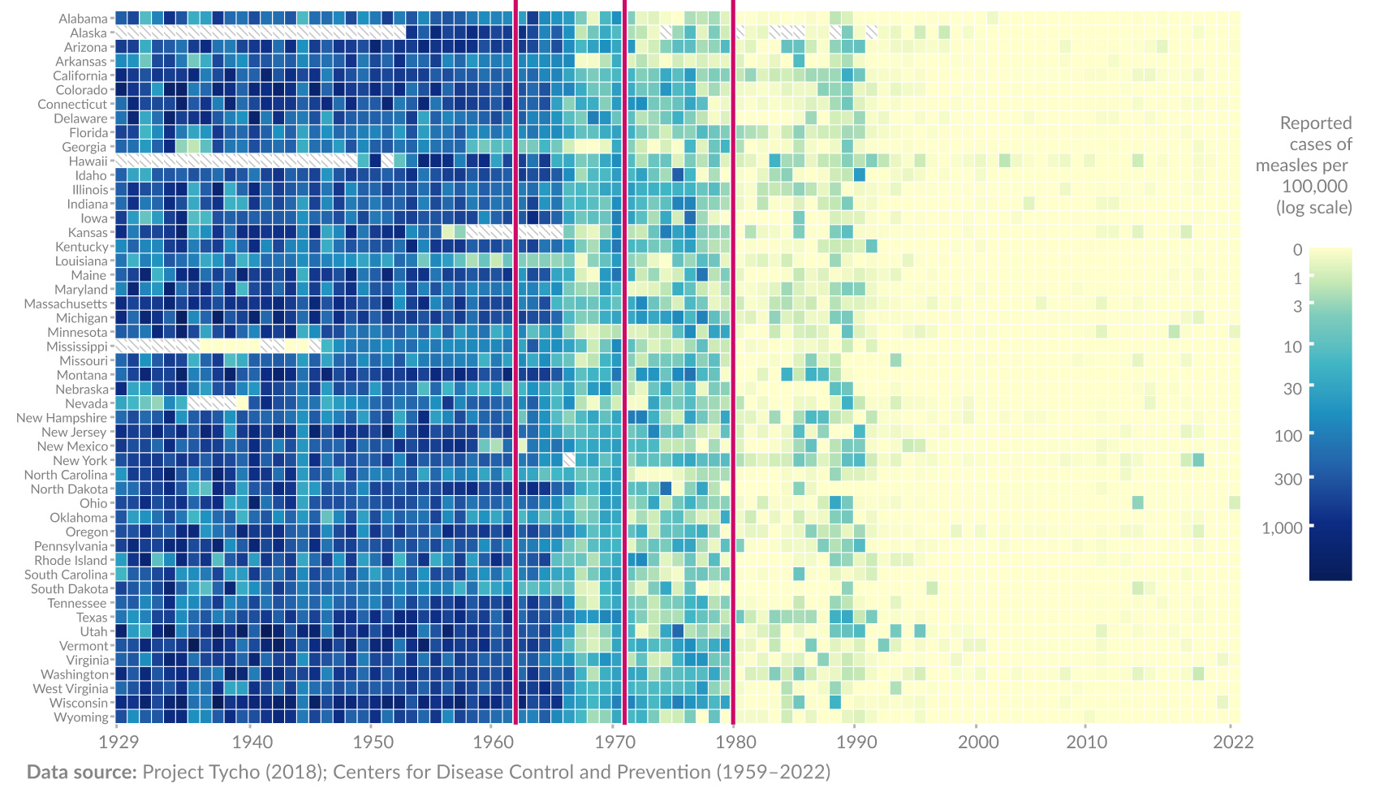
1971: Measles-mumps-rubella vaccine developed
1963: Measles vaccine developed
1980: Mandatory for kindergarteners to be vaccinated
US States
Notes:
U.S. Trends (2020–2025)
Here’s a year-by-year breakdown of reported U.S. measles cases:
2020: 13 cases
2021: 49 cases
2022: 121 cases
2023: 59 cases
2024: 285 cases
2025 (to date): Approximately 1,288 cases

Slide 20
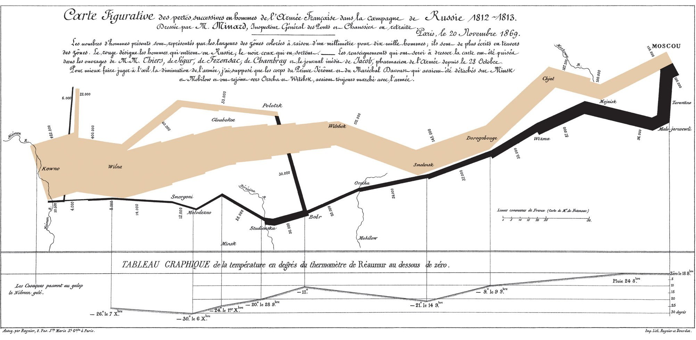
Napoleon’s Disastrous invasion of Russia in 1812
Notes:
The orange and black columns crossing the map show the French Grande Armée on its march to and from Moscow. The width of the column shows the size of the army – ever-shrinking as thousands of Napoleon’s soldiers died of disease, cold, starvation and Russian attacks. This image brilliantly displays the devastation of Napoleon’s army over the winter of 1812-13. It has been called “the best statistical graph ever drawn”.
Napoleon invaded Russia in June 1812, marching his army of 680,000 soldiers across the river Neman. He hoped to force Tsar Alexander I of Russia to stop trading with Britain, and finally force the British to end their long wars against France. Instead, the Russian army retreated, refusing to give Napoleon the decisive battle he fought. The French forces marched on Moscow, but Cossack troops burned the countryside ahead of them, cutting off all sources of food and shelter. The campaign was a disaster, with 380,000 troops of the Grand Armee being killed. With his largest army shattered, Napoleon was forced to retreat across Europe, eventually being defeated by the Allied Sixth Coalition, and sent into exile on the island of Elba.
The black line straggling back from Moscow shows this terrible rate of casualties, and the temperature scale at the bottom of the image charts the freezing weather conditions of the Russian winter. In all, this image displays six types of data in two dimensions: the number of Napoleon’s troops; the distance travelled; temperature; latitude and longitude; direction of travel; and location relative to specific dates. The arrows coming off the main bar also let Minard show where smaller forces left the main army and later rejoined it.
Charles Minard was 31 at the time of the Russian campaign. He was an engineer, creating harbors and canals for the French state. In later life, he became fascinated by maps and charts to explain complex situations. He was willing to bend geography to better express the essentials of his data. Minard himself admitted:
“The aim of my carte figurative is less to express statistical results, better done by numbers, than to convey promptly to the eye the relation not given quickly by numbers requiring mental calculation.”
This chart, seen as his finest achievement, was created in 1869, when Minard was over 80 years old.

Slide 21
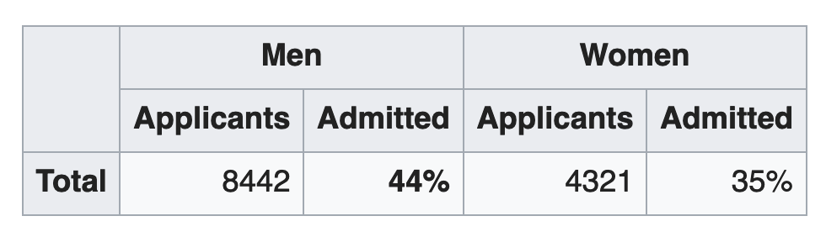
Gender Bias at Berkley (1973)
Are men applying to Berkeley more likely to get in than women?

Slide 22
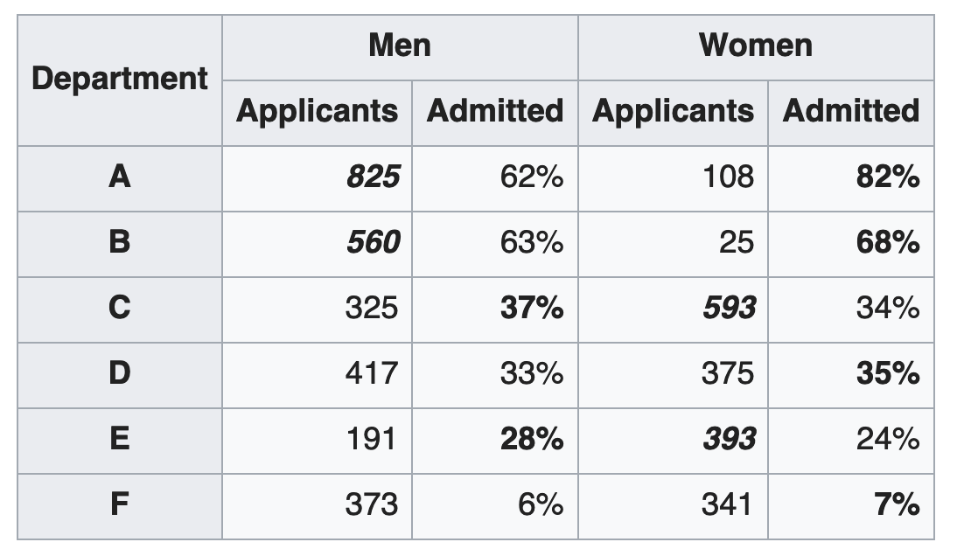
Gender Bias at Berkley (1973)
Are men applying to Berkeley more likely to get in than women?
Departments have different acceptance rates,
More women applied to departments with lower acceptance rates
Notes:
Was Berkley biased in their enrollments?
What would be a better question?

Slide 23
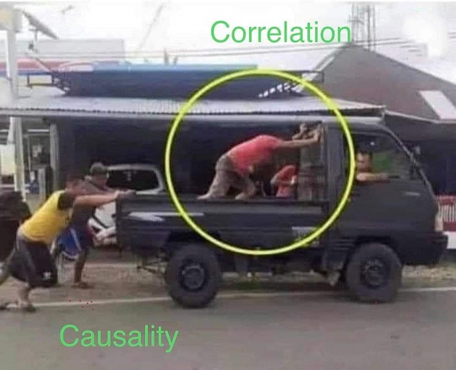
Spurious Correlations
Notes:
Correlation r = 0.9313793 (Pearson correlation coefficient) Correlation is a measure of how much the variables move together. If it is 0.99, when one goes up the other goes up. If it is 0.02, the connection is very weak or non-existent. If it is -0.99, then when one goes up the other goes down. If it is 1.00, you probably messed up your correlation function. r² = 0.8674674 (Coefficient of determination) This means 86.7% of the change in the one variable (i.e., UFO sightings in South Carolina) is predictable based on the change in the other (i.e., Popularity of the first name Annabelle) over the 47 years from 1975 through 2021. p < 0.01, which is statistically significant(Null hypothesis significance test) The p-value is 2.3E-21.^{Show} The p-value is a measure of how probable it is that we would randomly find a result this extreme.^{Note} On average, you will find a correaltion as strong as 0.93 in 2.3E-19% of random cases. Said differently, if you correlated 441,924,063,127,615,045,632 random variables^{Note} with the same 46 degrees of freedom, ^{Note} you would randomly expect to find a correlation as strong as this one. [ 0.88, 0.96 ] 95% correlation confidence interval (using the Fisher z-transformation) Read more about the confidence interval

Slide 24
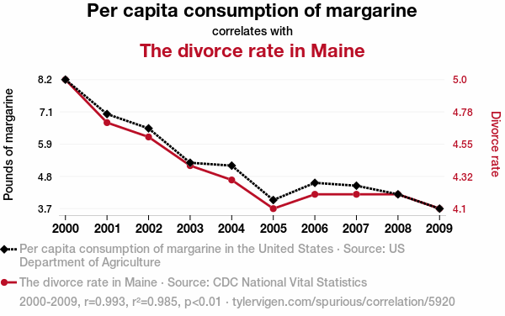
Spurious Correlations
Notes:
Correlation r = 0.9925585 (Pearson correlation coefficient) Correlation is a measure of how much the variables move together. If it is 0.99, when one goes up the other goes up. If it is 0.02, the connection is very weak or non-existent. If it is -0.99, then when one goes up the other goes down. If it is 1.00, you probably messed up your correlation function. r² = 0.9851723 (Coefficient of determination) This means 98.5% of the change in the one variable (i.e., The divorce rate in Maine) is predictable based on the change in the other (i.e., Per capita consumption of margarine) over the 10 years from 2000 through 2009. p < 0.01, which is statistically significant(Null hypothesis significance test) The p-value is 1.3E-8.^{Show} The p-value is a measure of how probable it is that we would randomly find a result this extreme.^{Note} On average, you will find a correaltion as strong as 0.99 in 1.3E-6% of random cases. Said differently, if you correlated 75,206,215 random variables^{Note} with the same 9 degrees of freedom, ^{Note} you would randomly expect to find a correlation as strong as this one. [ 0.97, 1 ] 95% correlation confidence interval (using the Fisher z-transformation) Read more about the confidence interval All values for the years included above: ^{Note}2000200120022003200420052006200720082009Per capita consumption of margarine (Pounds of margarine)8.276.55.35.244.64.54.23.7The divorce rate in Maine (Divorce rate)54.74.64.44.34.14.24.24.24.1

Slide 25
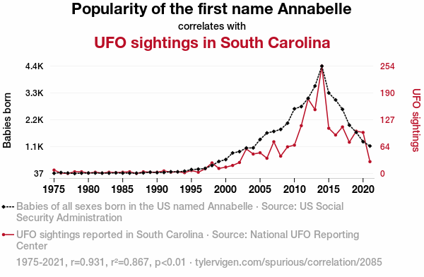
Spurious Correlations
https://www.tylervigen.com/spurious-correlations
Notes:
Correlation r = 0.9313793 (Pearson correlation coefficient) Correlation is a measure of how much the variables move together. If it is 0.99, when one goes up the other goes up. If it is 0.02, the connection is very weak or non-existent. If it is -0.99, then when one goes up the other goes down. If it is 1.00, you probably messed up your correlation function. r² = 0.8674674 (Coefficient of determination) This means 86.7% of the change in the one variable (i.e., UFO sightings in South Carolina) is predictable based on the change in the other (i.e., Popularity of the first name Annabelle) over the 47 years from 1975 through 2021. p < 0.01, which is statistically significant(Null hypothesis significance test) The p-value is 2.3E-21.^{Show} The p-value is a measure of how probable it is that we would randomly find a result this extreme.^{Note} On average, you will find a correaltion as strong as 0.93 in 2.3E-19% of random cases. Said differently, if you correlated 441,924,063,127,615,045,632 random variables^{Note} with the same 46 degrees of freedom, ^{Note} you would randomly expect to find a correlation as strong as this one. [ 0.88, 0.96 ] 95% correlation confidence interval (using the Fisher z-transformation) Read more about the confidence interval

Slide 26
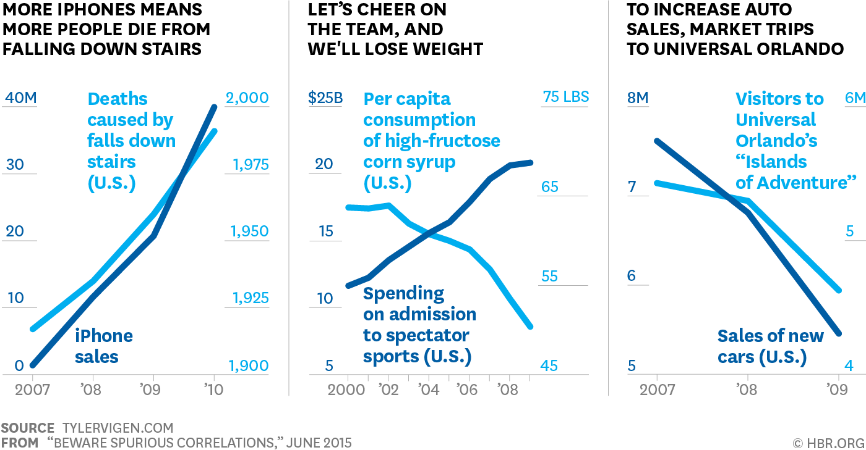
Notes:
Correlation r = 0.9313793 (Pearson correlation coefficient) Correlation is a measure of how much the variables move together. If it is 0.99, when one goes up the other goes up. If it is 0.02, the connection is very weak or non-existent. If it is -0.99, then when one goes up the other goes down. If it is 1.00, you probably messed up your correlation function. r² = 0.8674674 (Coefficient of determination) This means 86.7% of the change in the one variable (i.e., UFO sightings in South Carolina) is predictable based on the change in the other (i.e., Popularity of the first name Annabelle) over the 47 years from 1975 through 2021. p < 0.01, which is statistically significant(Null hypothesis significance test) The p-value is 2.3E-21.^{Show} The p-value is a measure of how probable it is that we would randomly find a result this extreme.^{Note} On average, you will find a correaltion as strong as 0.93 in 2.3E-19% of random cases. Said differently, if you correlated 441,924,063,127,615,045,632 random variables^{Note} with the same 46 degrees of freedom, ^{Note} you would randomly expect to find a correlation as strong as this one. [ 0.88, 0.96 ] 95% correlation confidence interval (using the Fisher z-transformation) Read more about the confidence interval

Slide 27
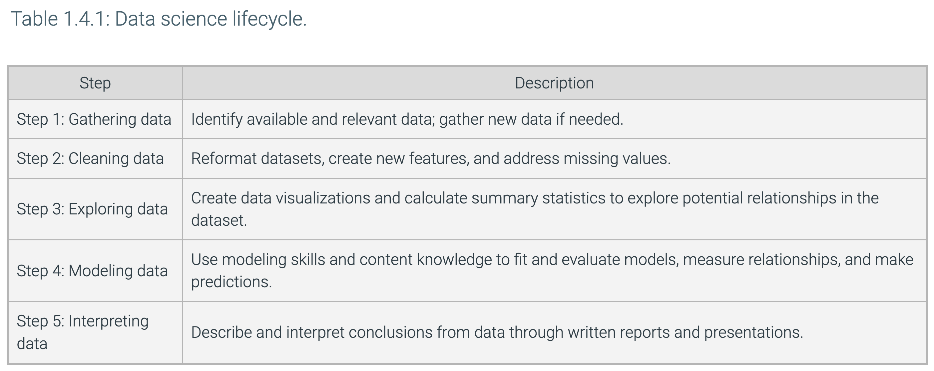
zyBook Data Science Lifecycle for Data Analysis

Slide 28
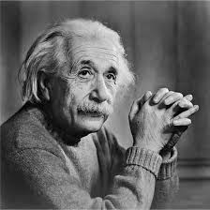
Define the Problem
What is the core problem?
What processes, systems, orgs are affected?
If solved, what is business value?
How can problem be scoped?
How is value measured?
Characterize problem domain
Is this a data-driven problem?
What data is needed? (prelim)
“
If I had an hour to solve a problem I'd spend 55 minutes
thinking about the problem and 5 minutes thinking about solutions.
“
Albert Einstein
Notes:
Some times we jump into working on a solution before carefully determining the actual problem. The real problem may be something completely different than what is seen at first glance.
For example, while working for AT&T on customer churn we thought that if we just had a model to predict who would churn, then we could use that model to make significant impacts in churn reduction. But what was the real problem?
If we could predict someone would churn, we still might not improve retention, why?
Some of the subscribers were going to churn anyway, no matter what we did. Others were going to stay, no matter what we did. Instead of predicting churners, we actually needed to segment out those that were either out the door or loyalists. Also, there was a segment we called “let sleeping dogs lie.” That is, any contact could cause them to wake up and churn. So we focused on modeling which customers that were predicted to churn would change their minds based on the marketing treatment (e.g., free phone, additional data, etc.). We needed to know of those likely to churn, who would positively respond to a given marketing treatment. That was the real problem. Also, we had the constraint that the marketing treatment needed to be financially justified.

Slide 29
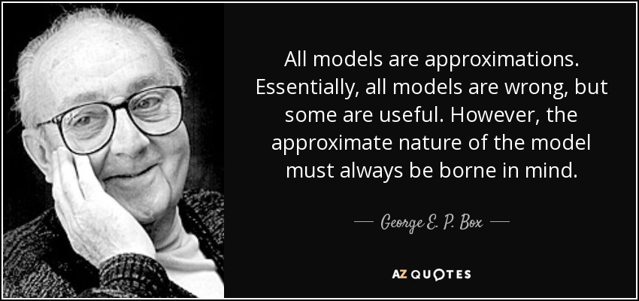
4. Build the Model
Notes:
George E. P. Box (1919–2013) was a British statistician renowned for his influential work in the fields of statistical modeling, quality control, and experimental design. Some key highlights of his legacy include:
1. Pioneering Work in Statistical Quality Control
Box made foundational contributions to industrial statistics and quality improvement, especially through his collaborations with W. Edwards Deming and others in the development of statistical process control techniques.
2. Box-Jenkins Methodology
He co-developed the Box-Jenkins methodology for time series analysis, which remains a cornerstone in forecasting models, especially ARIMA (AutoRegressive Integrated Moving Average) models.
3. Box-Cox Transformation
He co-authored the Box-Cox transformation, a method for transforming non-normal dependent variables into a normal shape, often used in regression and ANOVA.
4. Design of Experiments (DOE)
Box advanced the field of design of experiments, particularly in the context of industrial and scientific settings, emphasizing practical approaches that help engineers and scientists improve processes.
5. Famous Quote
He is often quoted for saying:
“All models are wrong, but some are useful.”
This encapsulates his pragmatic philosophy on the use of statistical models — acknowledging their limitations while emphasizing their value in understanding and improving real-world systems.

Slide 30
2. Identify and Acquire the Data
Source Data
Detailed data needed to address problem
Where is data?
Minimum data needed for MVP
Strategy to collect all data
Join data sources
ETL tools, processes, execution
Result: Raw Analytic Data Set or View
Run | Type | Accuracy | Precision | Sensitivity | Acc+Sen
1 | Binary | 91.00% | 47.00% | 0.25% | 94.00%
2 | Binary | 78.00% | 22.00% | 1.00% | 94.40%
3 | Binary | 51.00% | 43.65% | 0.15% | 94.04%
4 | Binary | 91.00% | None | 0.00% | 94.00%
5 | Binary | 91.00% | None | 0.00% | 94.00%
6 | Binary | 92.00% | None | 0.00% | #VALUE!
7 | Binary | 91.00% | None | 0.00% | 82.40%
8 | Binary | 91.00% | None | 0.00% | 82.42%
9 | Binary | 91.00% | None | 0.00% | 84.52%
10 | Binary | 91.00% | 25.00% | 0.61% | 82.78%
11 | Binary | 77.00% | 20.37% | 64.56% | 84.57%
Billing Table
Run | Type | Accuracy | Precision | Sensitivity | Acc+Sen
1 | Binary | 91.00% | 47.00% | 0.25% | 94.00%
2 | Binary | 78.00% | 22.00% | 1.00% | 94.40%
3 | Binary | 51.00% | 43.65% | 0.15% | 94.04%
4 | Binary | 91.00% | None | 0.00% | 94.00%
5 | Binary | 91.00% | None | 0.00% | 94.00%
6 | Binary | 92.00% | None | 0.00% | #VALUE!
7 | Binary | 91.00% | None | 0.00% | 82.40%
8 | Binary | 91.00% | None | 0.00% | 82.42%
9 | Binary | 91.00% | None | 0.00% | 84.52%
10 | Binary | 91.00% | 25.00% | 0.61% | 82.78%
11 | Binary | 77.00% | 20.37% | 64.56% | 84.57%
Call Center Table
Run | Type | Accuracy | Precision | Sensitivity | Acc+Sen
1 | Binary | 91.00% | 47.00% | 0.25% | 94.00%
2 | Binary | 78.00% | 22.00% | 1.00% | 94.40%
3 | Binary | 51.00% | 43.65% | 0.15% | 94.04%
4 | Binary | 91.00% | None | 0.00% | 94.00%
5 | Binary | 91.00% | None | 0.00% | 94.00%
6 | Binary | 92.00% | None | 0.00% | #VALUE!
7 | Binary | 91.00% | None | 0.00% | 82.40%
8 | Binary | 91.00% | None | 0.00% | 82.42%
9 | Binary | 91.00% | None | 0.00% | 84.52%
10 | Binary | 91.00% | 25.00% | 0.61% | 82.78%
11 | Binary | 77.00% | 20.37% | 64.56% | 84.57%
Customer Profile Table
Web Activity Table
Run | Type | Accuracy | Precision | Sensitivity | Acc+Sen
1 | Binary | 91.00% | 47.00% | 0.25% | 94.00%
2 | Binary | 78.00% | 22.00% | 1.00% | 94.40%
3 | Binary | 51.00% | 43.65% | 0.15% | 94.04%
4 | Binary | 91.00% | None | 0.00% | 94.00%
5 | Binary | 91.00% | None | 0.00% | 94.00%
6 | Binary | 92.00% | None | 0.00% | #VALUE!
7 | Binary | 91.00% | None | 0.00% | 82.40%
8 | Binary | 91.00% | None | 0.00% | 82.42%
9 | Binary | 91.00% | None | 0.00% | 84.52%
10 | Binary | 91.00% | 25.00% | 0.61% | 82.78%
11 | Binary | 77.00% | 20.37% | 64.56% | 84.57%
Raw ADS
Potential variables required to solve business problem
Very wide data set
Derived, Joined and Transformed
A | B | C | D | E | F | G | H | I | J | K | L | M
Acct ID | Att 1 | Att 2 | Number | Add | Age | SSN | SSN | SSN | SSN | SSN | SSN | SSN
12345 | ajklfff | 33efjgkl | 33efjgk | 33efjgkl | 33efjgkl | 33efjgkl | 33efjg | 33efj | 33ef | 33ef | 33ef | 33ef
12346 | ajklfff | 33efjgkl | 33efjgk | 33efjgkl | 33efjgkl | 33efjgkl | fjfkl | 123 | kjj | 666 | 4236 | 4425
12347 | ajklfff | 33efjgkl | 33efjgk | 33efjgkl | 33efjgkl | 33efjgkl | fjfkl | 123 | kjj | 666 | 4236 | 4425
12348 | ajklfff | 33efjgkl | 33efjgk | 33efjgkl | 33efjgkl | 33efjgkl | fjfkl | 123 | kjj | 666 | 4236 | 4425
12349 | ajklfff | 33efjgkl | efjgklk | 33efjgkl | 33efjgkl | 33efjgkl | fjfkl | 123 | kjj | 666 | 4236 | 4425
12350 | ajklfff | 33efjgkl | 33efklk | 33efjgkl | 33efjgkl | 33efjgkl | fjfkl | 123 | kjj | 666 | 4236 | 4425
12351 | ajklfff | 33efjgkl | #%$GG | 33efjgkl | 33efjgkl | 33efjgkl | fjfkl | 123 | kjj | 666 | 4236 | 4425
Notes:
Identifying and acquiring the data is the most time-consuming activity of your project. Jump on this early. Be politely persistent with your sponsor to get the data. They may need to first clean and sanitize it before they have permission to share with you.
This may be an iterative process. You may need to repeat this process many times during the project. Think about how you might automate the process.

Slide 31
3. Understand and Prepare the Data
Modeling Ready ADS
A | C | E | F | K | M
Acct ID | Att 2 | Att 31 | Age | SSN | REV
12345 | 33efjgkl | 33efjgkl | 33efjgkl | 33ef | 33ef
12346 | 33efjgkl | 33efjgkl | 33efjgkl | 666 | 4425
12347 | 33efjgkl | 33efjgkl | 33efjgkl | 666 | 4425
12348 | 33efjgkl | 33efjgkl | 33efjgkl | 666 | 4425
12349 | 33efjgkl | 33efjgkl | 33efjgkl | 666 | 4425
12350 | 33efjgkl | 33efjgkl | 33efjgkl | 666 | 4425
12351 | 33efjgkl | 33efjgkl | 33efjgkl | 666 | 4425
12345 | 33efjgkl | 33efjgkl | 33efjgkl | 33ef | 2223
12346 | 33efjgkl | 33efjgkl | 33efjgkl | 666 | 4425
12347 | 33efjgkl | 33efjgkl | 33efjgkl | 666 | 4425
12348 | 33efjgkl | 33efjgkl | 33efjgkl | 666 | 4425
12349 | 33efjgkl | 33efjgkl | 33efjgkl | 666 | 4425
12350 | 33efjgkl | 33efjgkl | 33efjgkl | 666 | 4425
12351 | 33efjgkl | 33efjgkl | 33efjgkl | 666 | 4425
2345 | Fjlkd | Jlkjf | Fjfjf | 345 | 0123
Run | Type | Accuracy | Precision | Sensitivity | Acc+Sen
1 | Binary | 91.00% | 47.00% | 0.25% | 94.00%
2 | Binary | 78.00% | 22.00% | 1.00% | 94.40%
3 | Binary | 51.00% | 43.65% | 0.15% | 94.04%
4 | Binary | 91.00% | None | 0.00% | 94.00%
5 | Binary | 91.00% | None | 0.00% | 94.00%
6 | Binary | 92.00% | None | 0.00% | #VALUE!
7 | Binary | 91.00% | None | 0.00% | 82.40%
8 | Binary | 91.00% | None | 0.00% | 82.42%
9 | Binary | 91.00% | None | 0.00% | 84.52%
10 | Binary | 91.00% | 25.00% | 0.61% | 82.78%
11 | Binary | 77.00% | 20.37% | 64.56% | 84.57%
Clean Data (missing / corrupted values)
Outlier analysis
Explore Data (EDA)
Visualize Data
Transform Data (e.g., Normalize)
Generate Features
Create Analytic Data Set (ADS)
Billing Table
Run | Type | Accuracy | Precision | Sensitivity | Acc+Sen
1 | Binary | 91.00% | 47.00% | 0.25% | 94.00%
2 | Binary | 78.00% | 22.00% | 1.00% | 94.40%
3 | Binary | 51.00% | 43.65% | 0.15% | 94.04%
4 | Binary | 91.00% | None | 0.00% | 94.00%
5 | Binary | 91.00% | None | 0.00% | 94.00%
6 | Binary | 92.00% | None | 0.00% | #VALUE!
7 | Binary | 91.00% | None | 0.00% | 82.40%
8 | Binary | 91.00% | None | 0.00% | 82.42%
9 | Binary | 91.00% | None | 0.00% | 84.52%
10 | Binary | 91.00% | 25.00% | 0.61% | 82.78%
11 | Binary | 77.00% | 20.37% | 64.56% | 84.57%
Call Center Table
Run | Type | Accuracy | Precision | Sensitivity | Acc+Sen
1 | Binary | 91.00% | 47.00% | 0.25% | 94.00%
2 | Binary | 78.00% | 22.00% | 1.00% | 94.40%
3 | Binary | 51.00% | 43.65% | 0.15% | 94.04%
4 | Binary | 91.00% | None | 0.00% | 94.00%
5 | Binary | 91.00% | None | 0.00% | 94.00%
6 | Binary | 92.00% | None | 0.00% | #VALUE!
7 | Binary | 91.00% | None | 0.00% | 82.40%
8 | Binary | 91.00% | None | 0.00% | 82.42%
9 | Binary | 91.00% | None | 0.00% | 84.52%
10 | Binary | 91.00% | 25.00% | 0.61% | 82.78%
11 | Binary | 77.00% | 20.37% | 64.56% | 84.57%
Customer Profile Table
Web Activity Table
Run | Type | Accuracy | Precision | Sensitivity | Acc+Sen
1 | Binary | 91.00% | 47.00% | 0.25% | 94.00%
2 | Binary | 78.00% | 22.00% | 1.00% | 94.40%
3 | Binary | 51.00% | 43.65% | 0.15% | 94.04%
4 | Binary | 91.00% | None | 0.00% | 94.00%
5 | Binary | 91.00% | None | 0.00% | 94.00%
6 | Binary | 92.00% | None | 0.00% | #VALUE!
7 | Binary | 91.00% | None | 0.00% | 82.40%
8 | Binary | 91.00% | None | 0.00% | 82.42%
9 | Binary | 91.00% | None | 0.00% | 84.52%
10 | Binary | 91.00% | 25.00% | 0.61% | 82.78%
11 | Binary | 77.00% | 20.37% | 64.56% | 84.57%
A | B | C | D | E | F | G | H | I | J | K | L | M
Acct ID | Att 1 | Att 2 | Number | Add | Age | SSN | SSN | SSN | SSN | SSN | SSN | SSN
12345 | ajklfff | 33efjgkl | 33efjgk | 33efjgkl | 33efjgkl | 33efjgkl | 33efjg | 33efj | 33ef | 33ef | 33ef | 33ef
12346 | ajklfff | 33efjgkl | 33efjgk | 33efjgkl | 33efjgkl | 33efjgkl | fjfkl | 123 | kjj | 666 | 4236 | 4425
12347 | ajklfff | 33efjgkl | 33efjgk | 33efjgkl | 33efjgkl | 33efjgkl | fjfkl | 123 | kjj | 666 | 4236 | 4425
12348 | ajklfff | 33efjgkl | 33efjgk | 33efjgkl | 33efjgkl | 33efjgkl | fjfkl | 123 | kjj | 666 | 4236 | 4425
12349 | ajklfff | 33efjgkl | efjgklk | 33efjgkl | 33efjgkl | 33efjgkl | fjfkl | 123 | kjj | 666 | 4236 | 4425
12350 | ajklfff | 33efjgkl | 33efklk | 33efjgkl | 33efjgkl | 33efjgkl | fjfkl | 123 | kjj | 666 | 4236 | 4425
12351 | ajklfff | 33efjgkl | #%$GG | 33efjgkl | 33efjgkl | 33efjgkl | fjfkl | 123 | kjj | 666 | 4236 | 4425
Notes:
After identifying and acquiring the data, data preparation is the most time consuming activity. You will take the rest of the semester to fully analyze your data set and prepare an EDA to present to the client.

Slide 32
4. Build the Model
Machine Learning
Supervised Learning
Regression
Classification
Reinforcement Learning
Decision Tree
Logistic Regression
XGBoost
Random Forest
Support Vector Machine
Linear Regression
Unsupervised
Learning
Clustering
K-Means
DBSCAN
Hierarchical
Dimensionality Reduction
PCA
SVD
Discriminant Analysis
Q-Learning
DQN
SARSA
Select algorithms
Define model metrics
Optimize hyper-parameters
Create cross-validation training & testing sets
Run & Validate models
Select best performing model set
Interpret Model output (e.g., LIME, SHAP)
Iterate to improve performance
Notes:
Supervised learning is a type of algorithm inferring a function from labeled training data. The training data consists of a set of training examples, each with input objects (independent variables) and the desired output object (dependent variable)
Unsupervised learning is a type of algorithm used to draw inferences from datasets consisting of input data without labeled responses – in other words, no dependent variable.
Reinforcement Learning is used in perception, robotics, navigation, gaming and learns by rewarding what the system considers positive behavior and punishing negative. I used a form of reinforcement learning called Hebbian Learning in my Ph.D. research on cooperative vision integration. In this case, different vision modalities like motion, stereo, color could cooperate to reinforce overall vision understanding. It is believed that the brain uses reinforcement learning to form memories by strengthening the electrical signals between synapses. SARSA =State-Action-Reward-State-Action, DQN = Deep Q Network
Classification/Regression – “Supervised Learning“
Linear Regression
Logistic Regression
Decision Trees
Random Forests
Support Vector Machines
Naïve Bayes
Neural Networks
…Implies a “Predictive” Model
Clustering/Segmentation – “Unsupervised Learning“
K-Means Clustering
Hierarchical clustering
Association Rules/Affinity Propagation
Principle Component Analysis

Slide 33
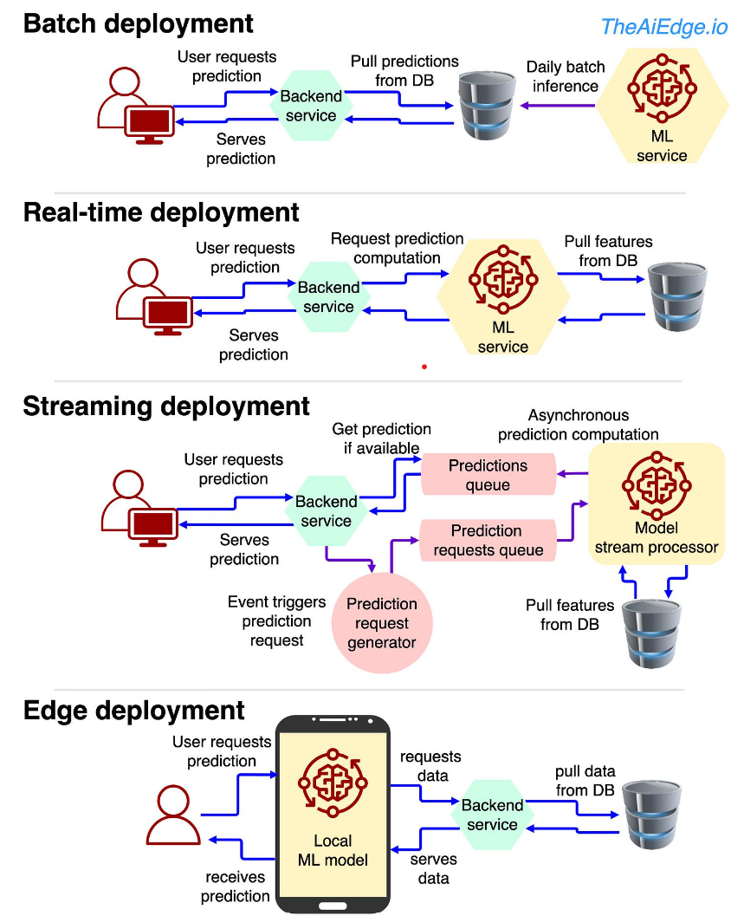
5. Deploy into Production
Deploy
Define requirements
ID business process, tools, & org changes
Determine deployment approach:
Batch Table
REST API Endpoint
Container
Pickle File, PMML, ONYX
Web Service
Stand alone application
Develop app S/W
Integrate with other systems
Prototype
Pilot
Full scale implementation
Deployment Patterns
Lost Opportunity
$$$ lost in opportunity cost for Analytics that are delayed reaching production

Slide 34
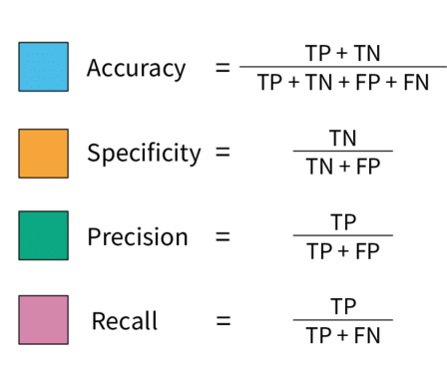
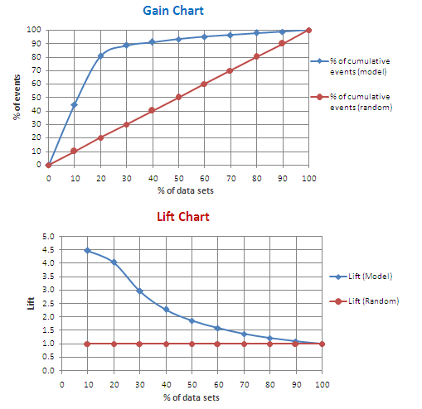
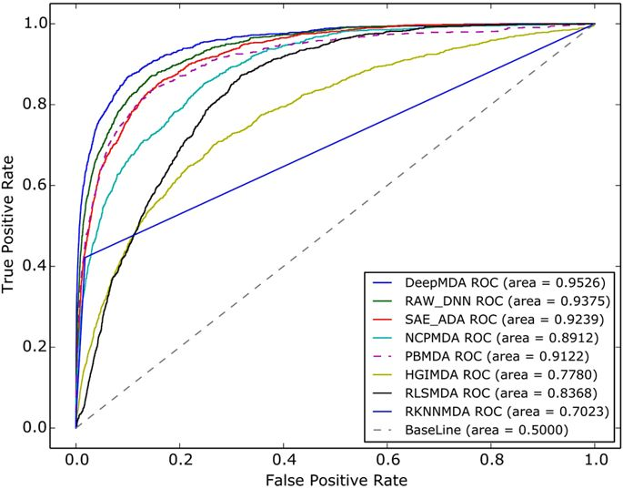
6. Manage and Measure Models in Production
Manage
Model
Repository
Model
Management
Model
Execution
Version Control
Collect data about all model performance
Store model code
Track training and testing sets
Track all model experiments
Trigger retraining when models drift
Run A/B testing
Evaluate model outputs against business goals
Model Metadata
Version Control
Training
Model Scoring Metadata
Automated Testing
Evaluation
Model Store
Release Management
Scoring
Lift Charts
Notes:
This stage is not in any normal Data Science process. However, as enterprises have matured their DS capabilities, there has been a growing need to address the issues of managing multiple models in production. The Model Management function will be critical for any organization to grow beyond a few models in production.
While I was working at AT&T we only had a dozen or so models in production at any given time. This is small enough that it can be done manually. However, while working at Teradata our customers typically had hundreds (Verizon) or thousands of models in production (VW). Other customers were looking to deploy millions. In these cases, it is impossible to manually manage that many models. This is were techniques in MLOps come to play. We'll save that for another time.

Slide 35
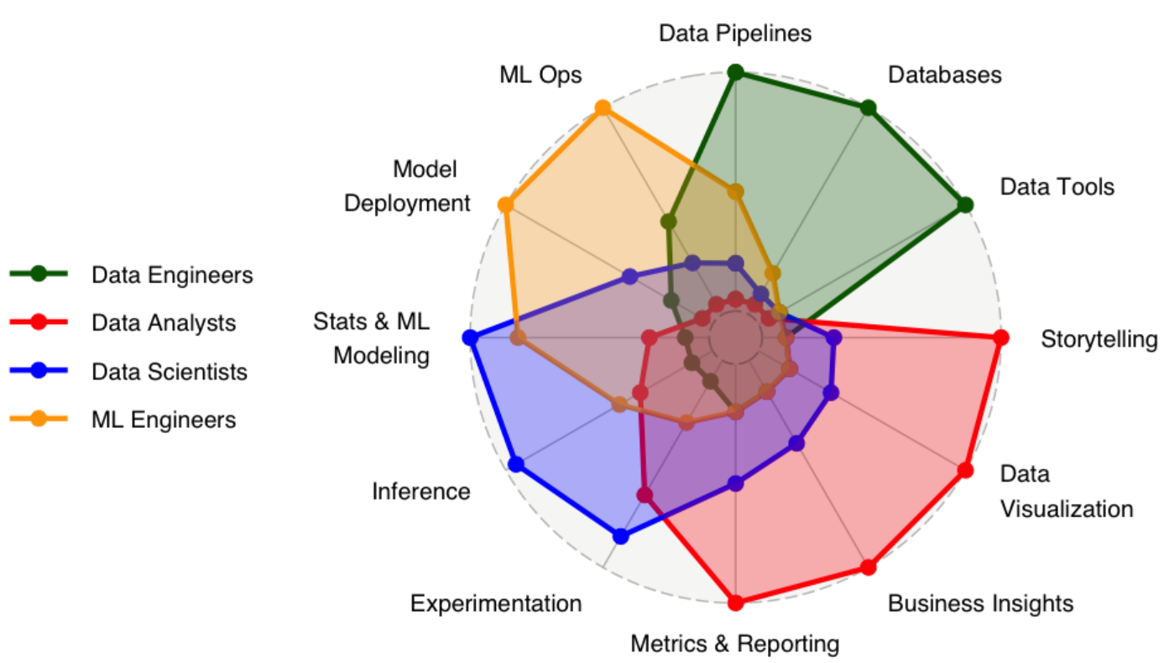
Spider chart of relative skills for key data roles
From https://www.datacaptains.com/blog/guide-to-data-roles

Slide 36
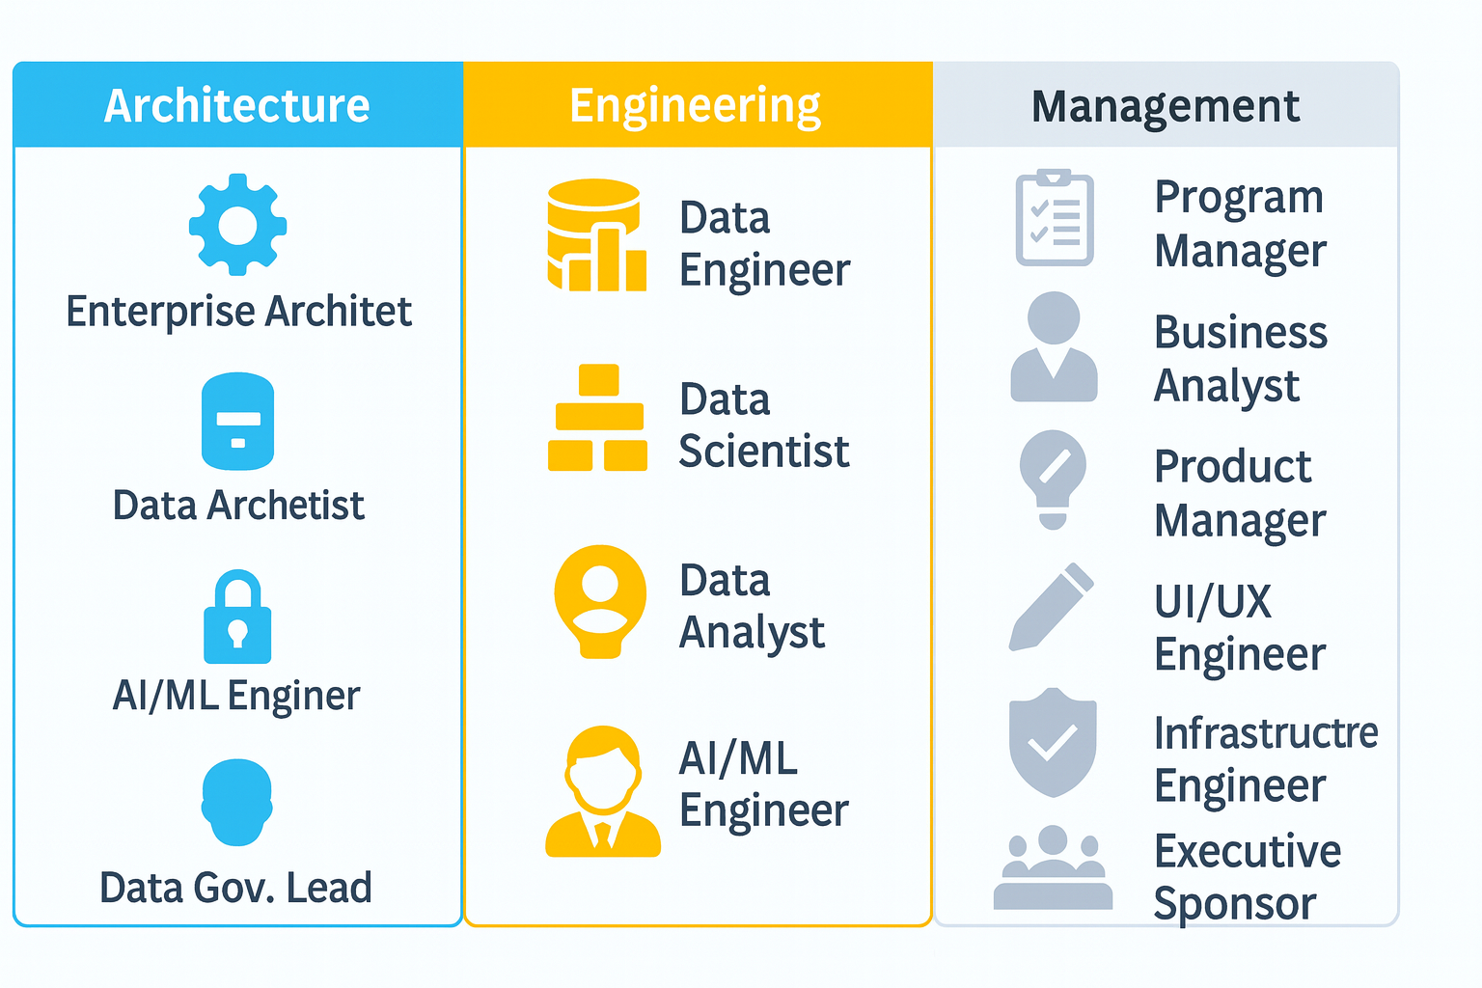
Roles on a Data Science Application Project
Notes:
I generated this list by reflecting on the last project I did with Nu Skin. In this case, every single one of these roles was touched at some point in the project.

Slide 37
Extended Roles on a Data Science Application Project
Role | Description
Data Engineer | Builds data pipelines, joins tables, converts data formats, prepares data for use by Data Scientists.
Data Scientist | Prepares data for modeling, extracts features, builds models
Data Analyst | Expert in SQL, BI, Excel, Analyzing data but not necessarily a domain expert (Tableau, PowerBI most popular tools)
AI/ML Engineer | Builds ML pipeline, integrate enterprise systems, monitor & manage models, skilled software engineer & data scientist
Enterprise Architect | Integrates DS applications into enterprise system (e.g., microservices, API gateway, event brokers, etc.)
Data Architect | Defines data management system architecture, data model
Data Governance Lead | Responsible for meta data, data catalog, data access, change management policies
Business Analyst | Expert in a particular domain (e.g., Finance), can use BI tools and Excel if set-up by the Data Analyst.
Program Manager | Keeps track of projects, personnel, budgets, identifies conflicts, dependencies, resource constraints
Application Engineer | Expert in technology for a particular domain or problem (e.g., Finance, Marketing, Sales, Manufacturing, etc.)
UI/UX Engineer | Designs, prototypes, and builds the user interface (mobile and web)
Product Manager | Responsible for overall product design, prioritization, deployment and assuring business value
Infrastructure Engineer | Expert in cloud and data management infrastructure
Security/Privacy Engineer | Assures application architecture is compliant with Enterprise security and privacy standards
Executive Sponsor | Oversees application development. Responsible for resourcing. Communicates with Executive Leadership.
Notes:
I generated this list by reflecting on the last project I did with Nu Skin. In this case, every single one of these roles was touched at some point in the project.

Slide 38
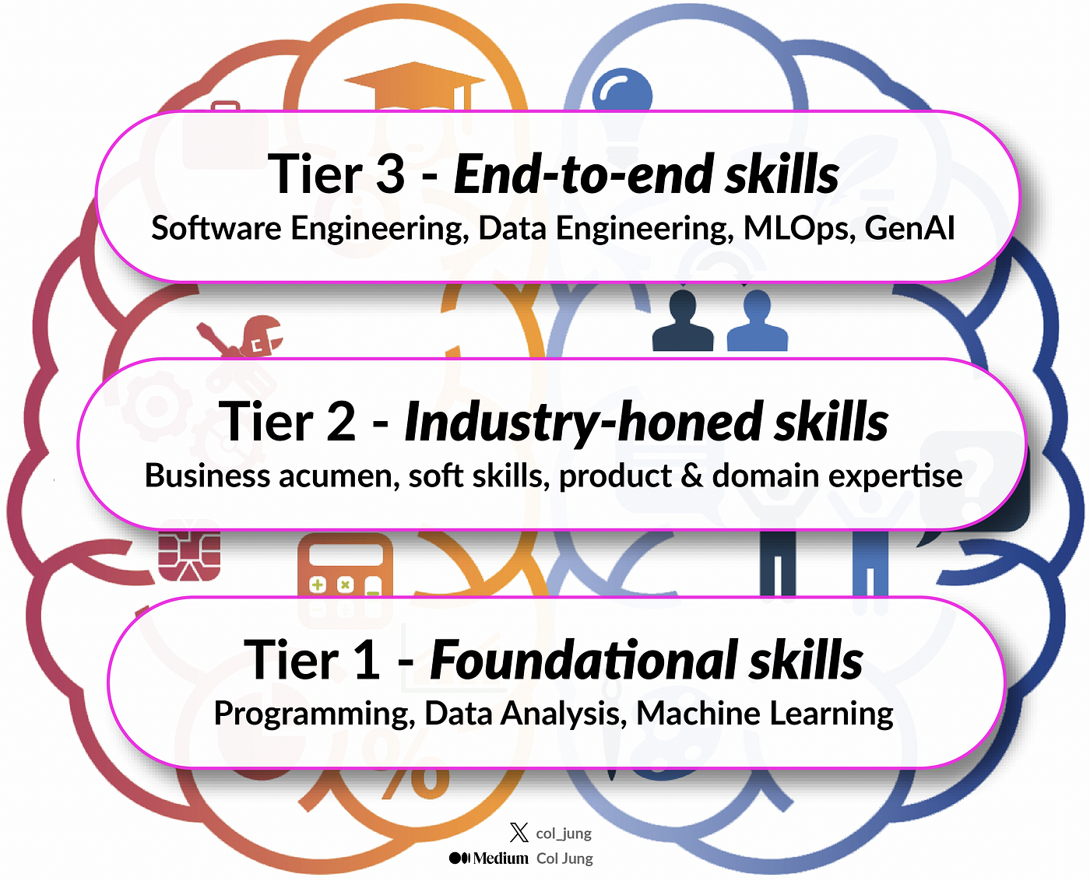
Skill Sets for Full Stack Data Scientists
“Evolution of Data Science: New Age Skills for the Modern End-to-End Data Scientist,” by Col Jung, Medium, July 23, 2024.

Slide 39
The Goal: Full-Stack Data Scientist and Beyond
Data Engineer: ETL Pipelines, SQL, Data Prep
Major: Languages, OS, Compiler, SE, Data Structures, Systems, etc.
Mental
Emotional
Data Analyst: Visualization, EDA, Reports
Minor: Math, Lang, Business, Econ, History, etc.
Social
Data Scientist: Build Predictive, Generative Models
General Ed: History, Languages, Math, Science
Physical
ML Engineer: Deploy, Monitor Models, Apps
Gospel: BofM, New Test, Old Test, D&C
Spiritual
Data Scientist
University Student
Human Being

Slide 40
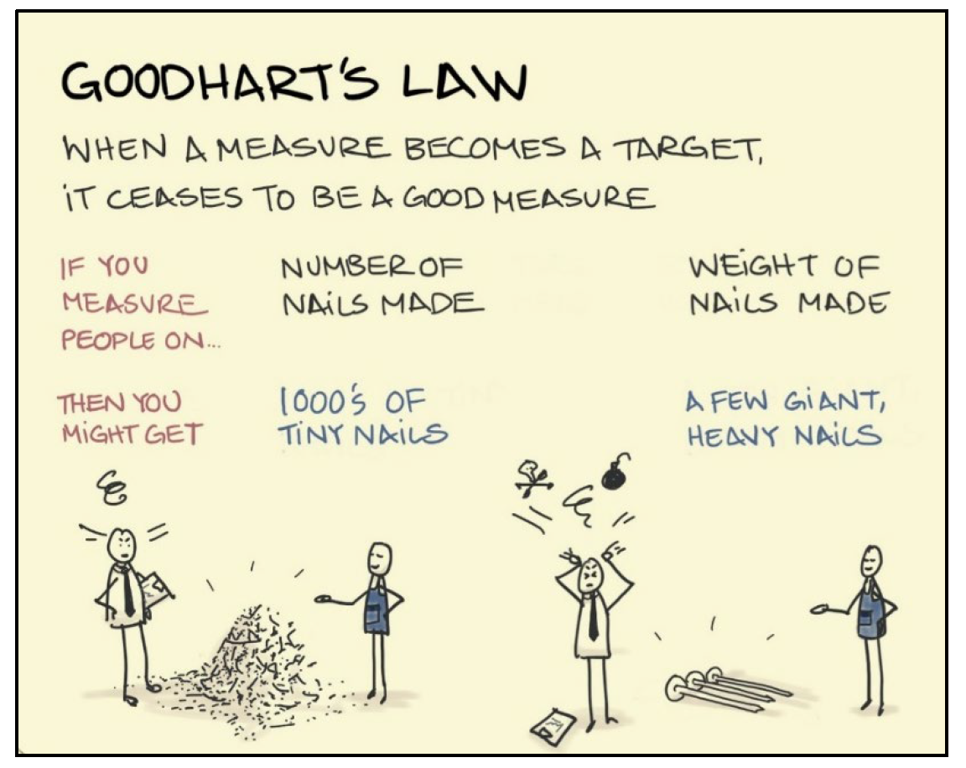
Good to know…
Don’t let school…
get in the way of your education ☺
Students understand this law very well. It is easy to get caught up focusing on getting the “A” instead of mastering the knowledge or skill.

